Slide 1
SEMICOLON TEAM WEB APPLICATIONS
Professor Nicola Ferro
Reihaneh Baghishani , Ali Erfanian Omidvar , Irem Goksu Celik , Hamideh Haeri , Ferdos Hajizadeh Chavari ,
Hossein Hosseinpour , Gulce Sirvanci , Ali Tahvildari , Mohammad Torabi

Slide 2

Contents
Objectives
Agile
Trello
Project Structure
Server-side
Main Functionalities
Entity-Relationship Schema
REST API Summary
REST Error Codes
Log System : Folder Structure
Log System : Log Structure
Authentication
Exception Handler
Figma Design
Contribution
Client-side

Slide 3
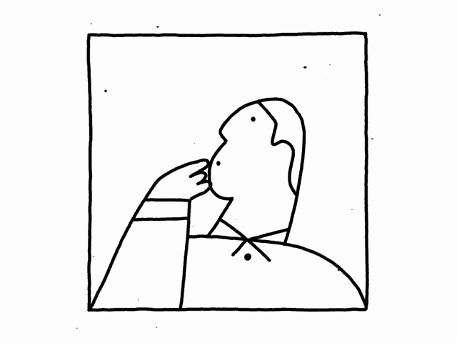
Objectives
Develop a secure and user-friendly platform for pharmacy staff to efficiently manage drugs, materials, prescriptions, and orders.
Create a system that maintains accurate records of inventory, suppliers, and sales, facilitating better decision-making for pharmacy staff.
Generate insightful reports to enhance productivity and effectiveness, while ensuring the secure and efficient management of drugs and materials.
1

Slide 4

Agile
Team Management Methodology: Scrum
2

Slide 5

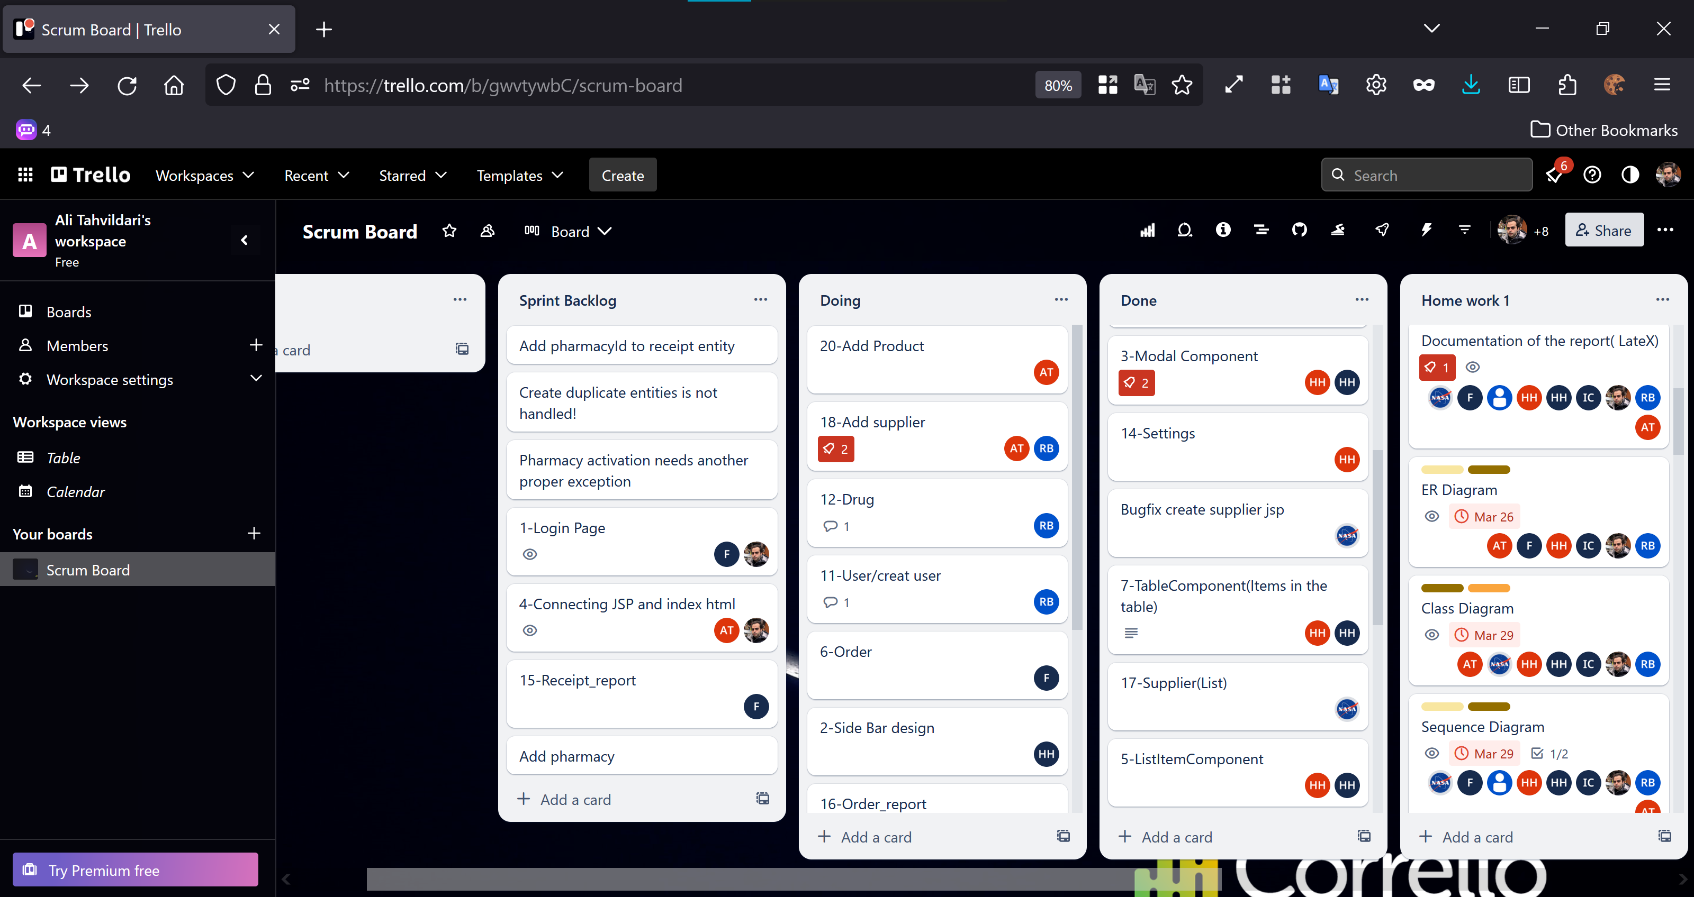
Trello
3

Slide 6
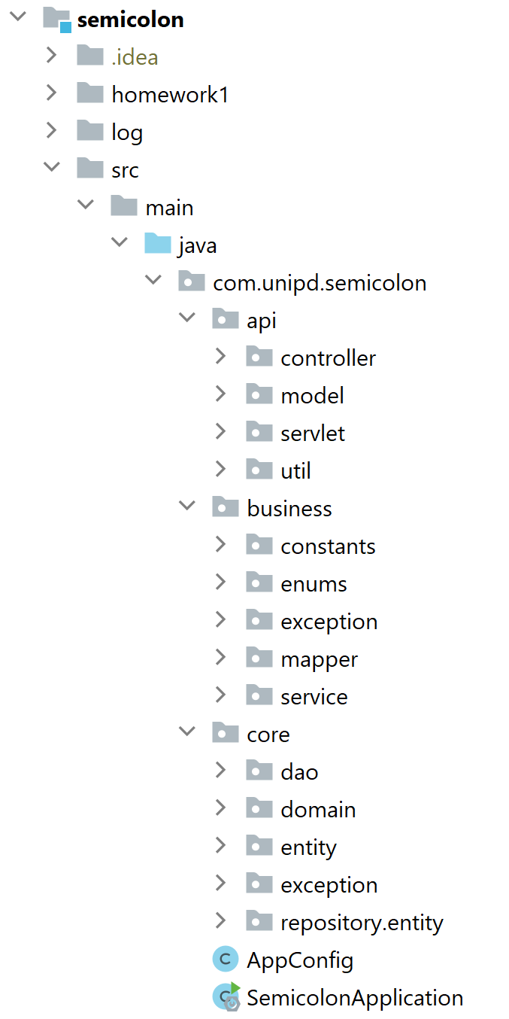

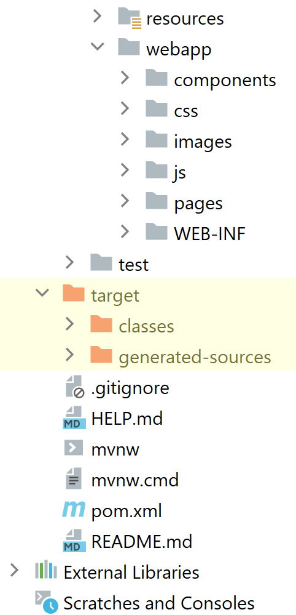
Project Structure
4

Slide 7

01
Server-side

Slide 8

Main Functionalities
Staff account management, prescription handling, and storage tracking
Efficient order management and supplier performance assessment
Comprehensive reporting, secure payment recording, and receipt generation
6

Slide 9
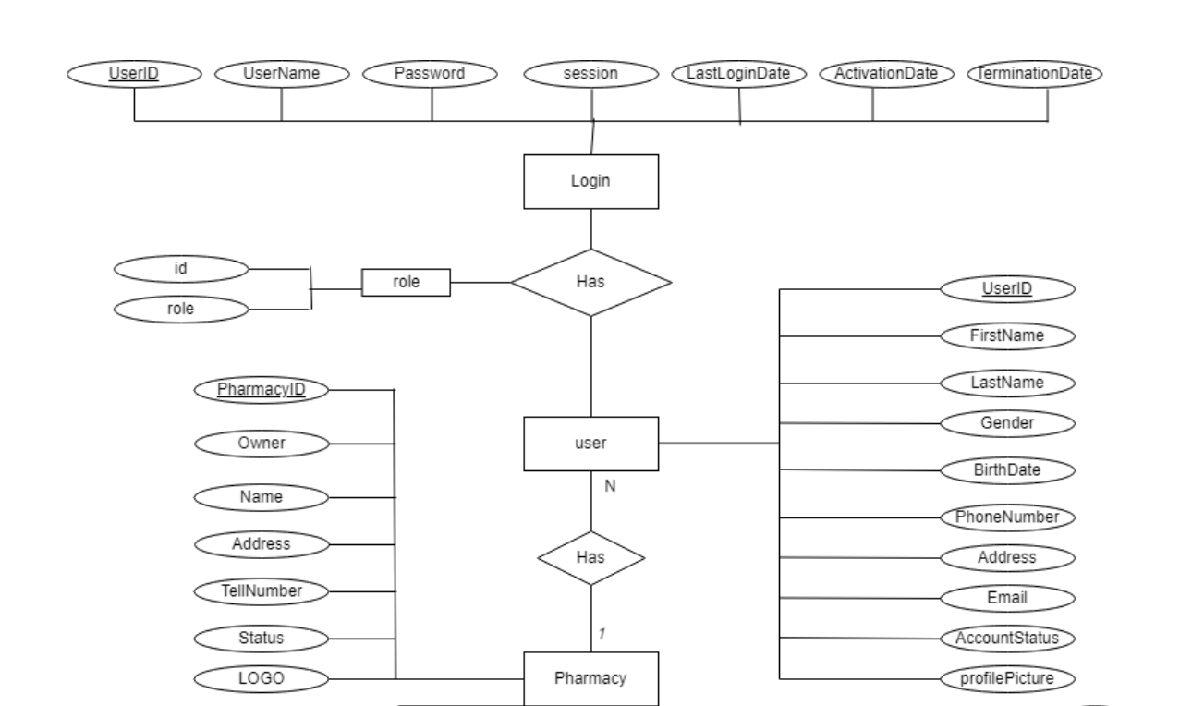
Entity-Relationship Schema
7

Slide 10
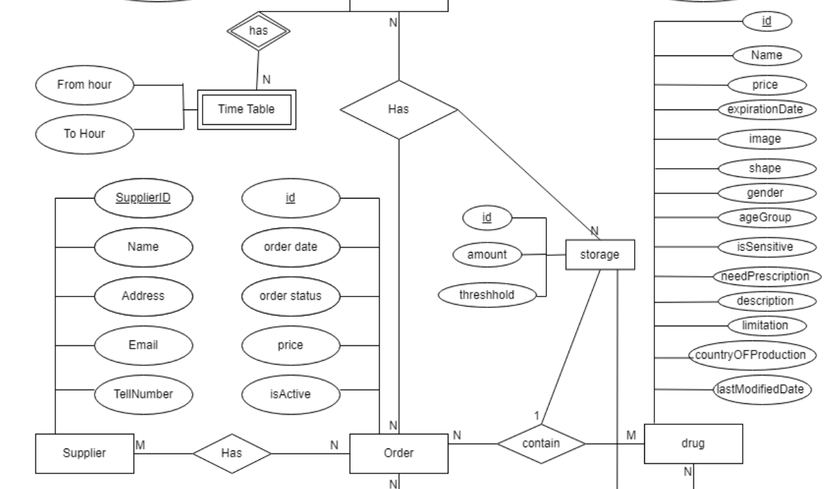
Entity-Relationship Schema
8

Slide 11
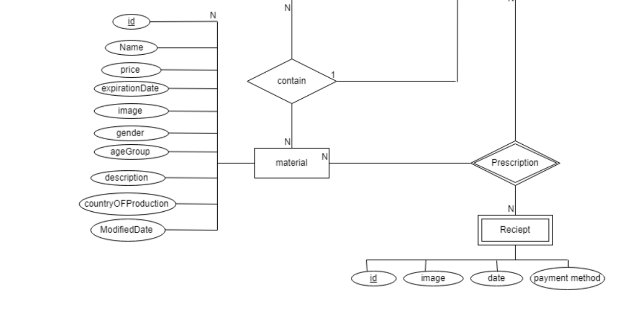
Entity-Relationship Schema
9

Slide 12

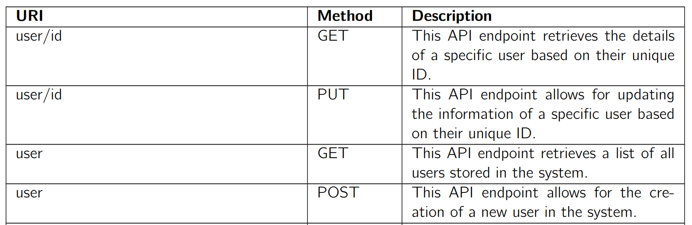

REST
Summary
10

Slide 13
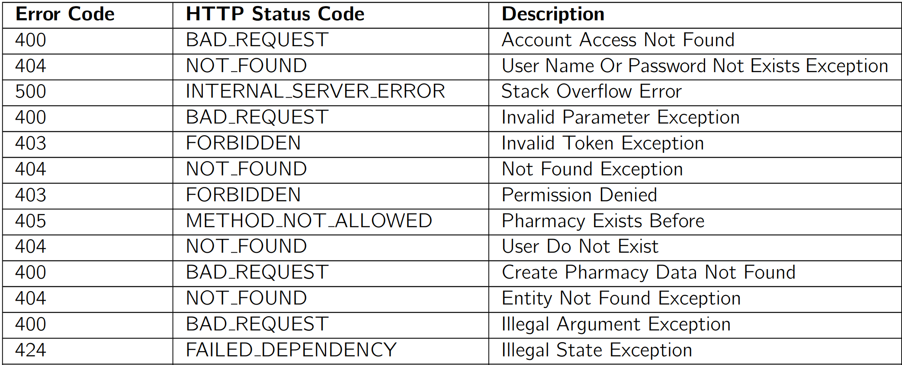

REST Error Codes
11

Slide 14
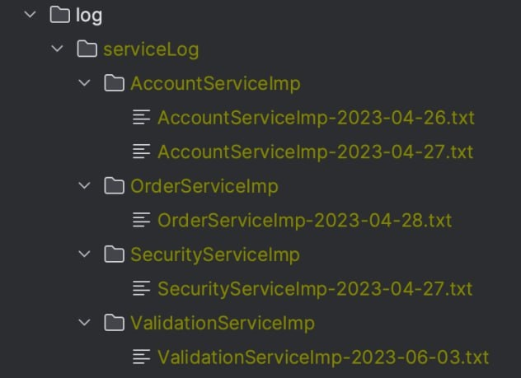
Log System : Folder Structure
12

Slide 15
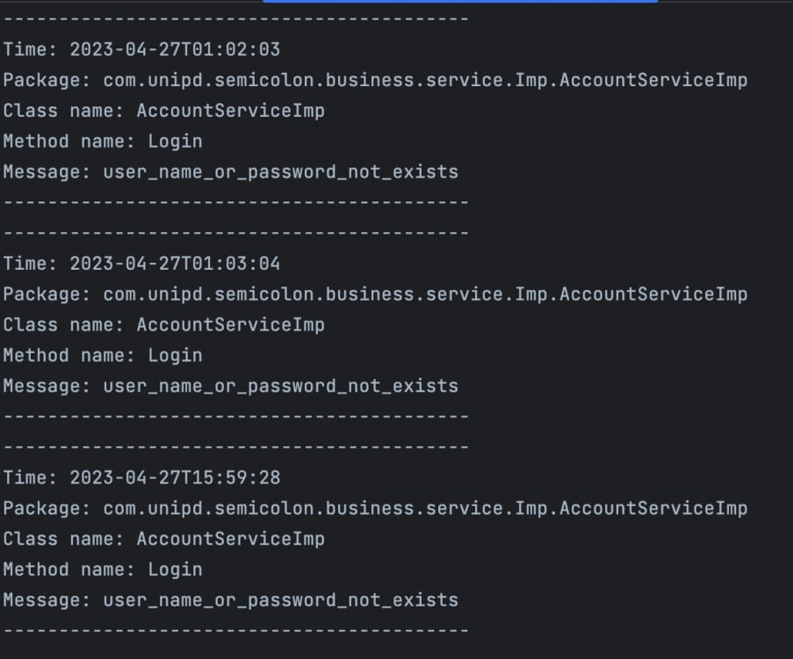
Log System : Log Structure
13

Slide 16

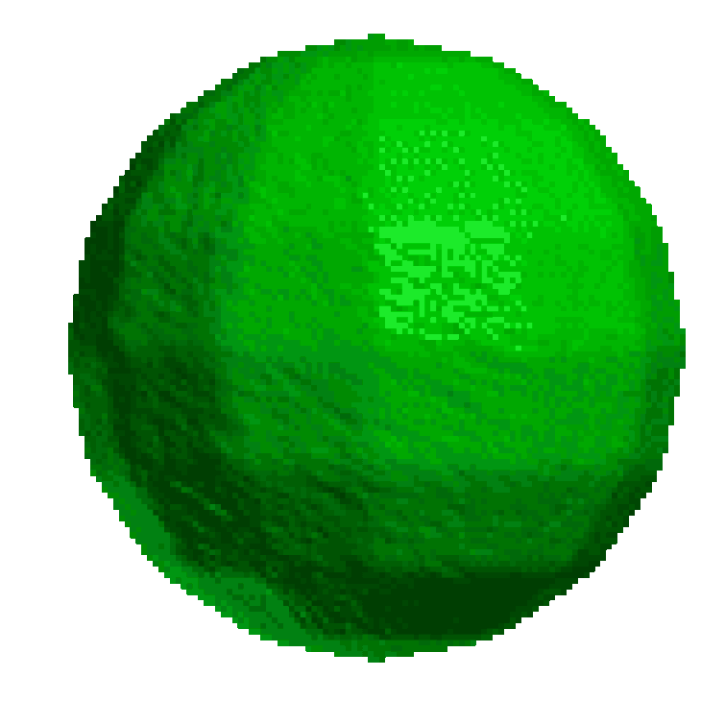

Authentication
String Service
Base64 Encoding and Decoding
Input: String
Output: String
Security Service
Create Token
Validate Token
Get Account ID
Get Role from Token
14

Slide 17

@Override public String createToken(String accountId, String role) { Claims claims = Jwts.claims().setSubject(accountId); claims.put("Role", role); Date validity = new Date(localTimeService.nowTime() + validityInMilliseconds * 1000000); return Jwts.builder() .setClaims(claims) .setIssuedAt(new Date()) .setExpiration(validity) .signWith(SignatureAlgorithm.HS256, secretKey) .compact(); }
15

Slide 18

@Override public boolean validateToken(String token) { return getParseToken(token) != null; }
16

Slide 19
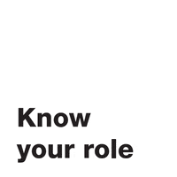
@Override public String getRoleFromToken(String token) { Claims claims = Jwts.parser().setSigningKey(secretKey).parseClaimsJws(token).getBody(); String role = (String) claims.get("Role"); return role.toLowerCase(); }
17

Slide 20



@Override public String getAccountId(String token) throws CustomException { try { return (getParseToken(token).getBody().getSubject()); } catch (CustomException e) { Throwable t = new Throwable(); StackTraceElement[] elements = t.getStackTrace(); logSystem.logUtil( "Class caller : " + elements[1].getClassName() + " | " + "Method :" + elements[1].getMethodName()); throw e; } }
18

Slide 21

private Jws<Claims> getParseToken(String token) throws CustomException { try { return Jwts.parser().setSigningKey(secretKey).parseClaimsJws(token); } catch (JwtException | IllegalArgumentException e) { Throwable t = new Throwable(); StackTraceElement[] elements = t.getStackTrace(); logSystem.logUtil( "Class caller : " + elements[1].getClassName() + " | " + "Method :" + elements[1].getMethodName() + "|" + " Msg : " + e.getMessage()); throw new InvalidTokenException(token); } }
19

Slide 22
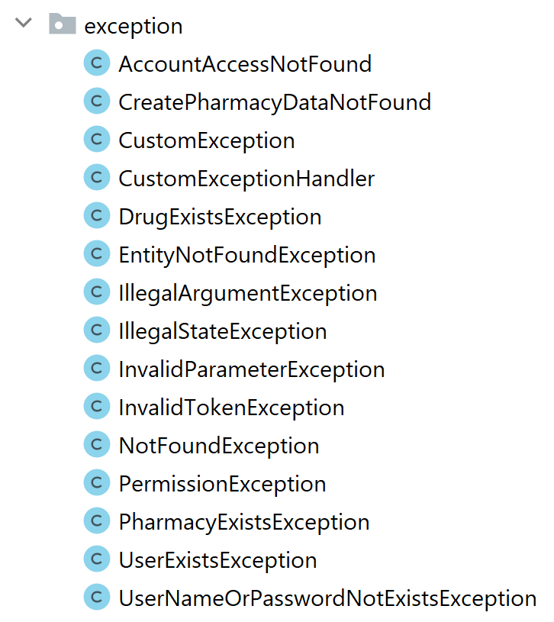
Exception Handler
@ControllerAdvice public class CustomExceptionHandler { @ExceptionHandler(StackOverflowError.class) @ResponseStatus(HttpStatus.INTERNAL_SERVER_ERROR) public CustomException handleStackOverflowError(StackOverflowError ex) { CustomException customException = new CustomException(); customException.setMsg("stack_overflow_error"); customException.setData(ex.getMessage()); return customException; } @ExceptionHandler(UserNameOrPasswordNotExistsException.class) @ResponseStatus(HttpStatus.NOT_FOUND) public CustomException handleUserNameOrPasswordNotExistsException(UserNameOrPasswordNotExistsException ex) { CustomException customException = new CustomException(); customException.setMsg(ex.getMsg()); customException.setStatus(ex.getStatus()); return customException; } }
For example
20

Slide 23

Figma Design

Slide 24
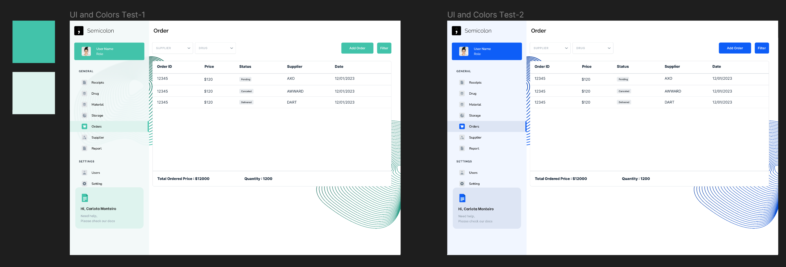
Picking Color Palette
22

Slide 25
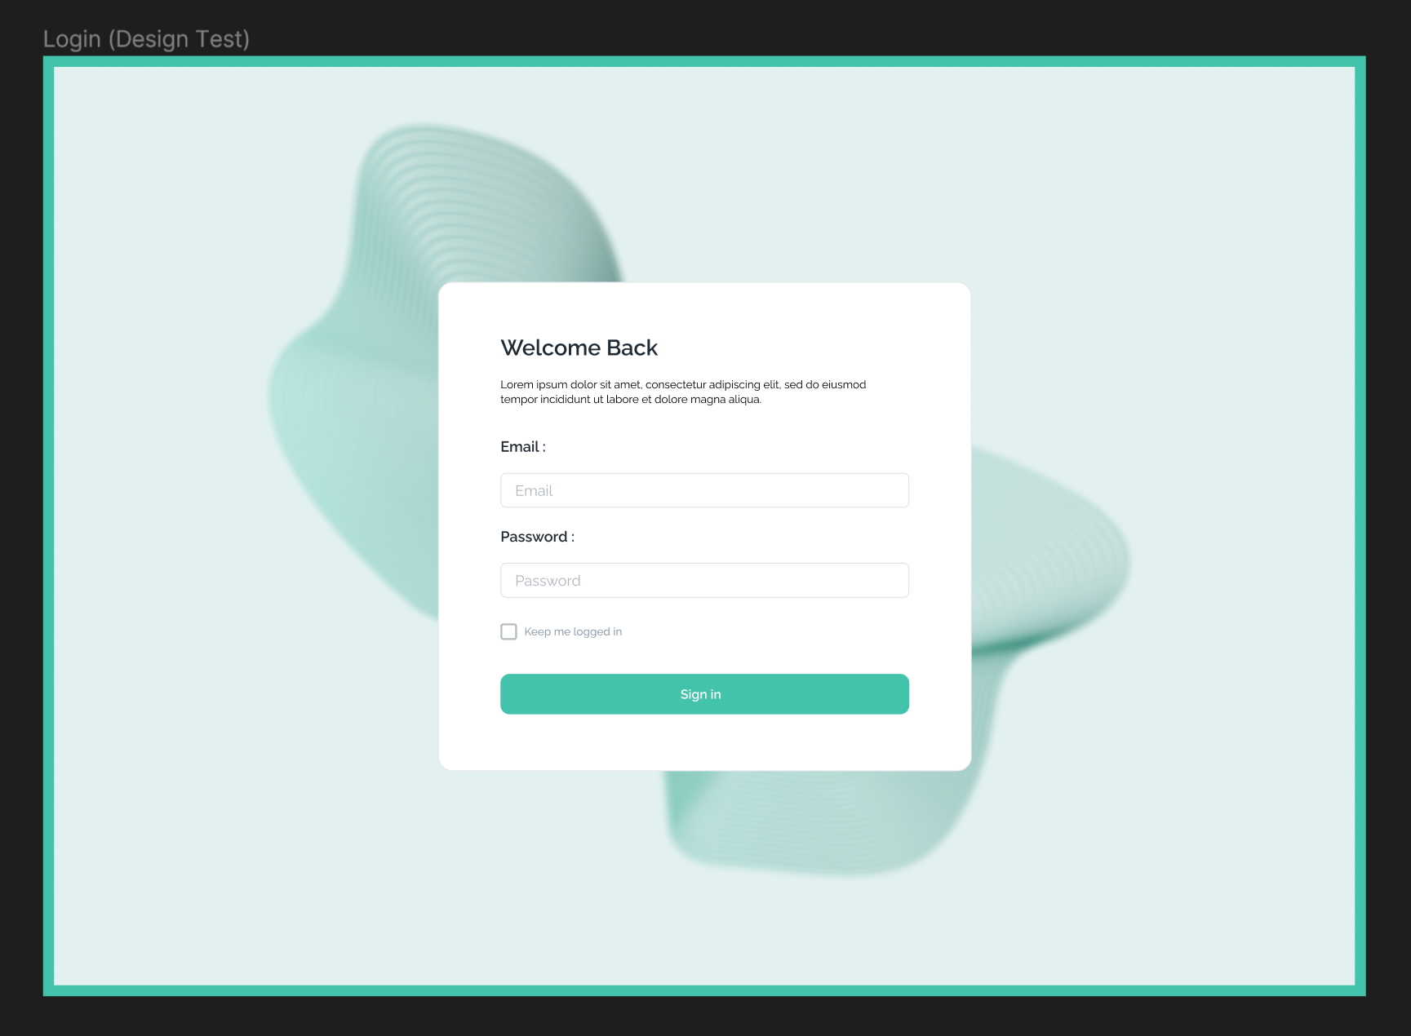
Login Design
23

Slide 26
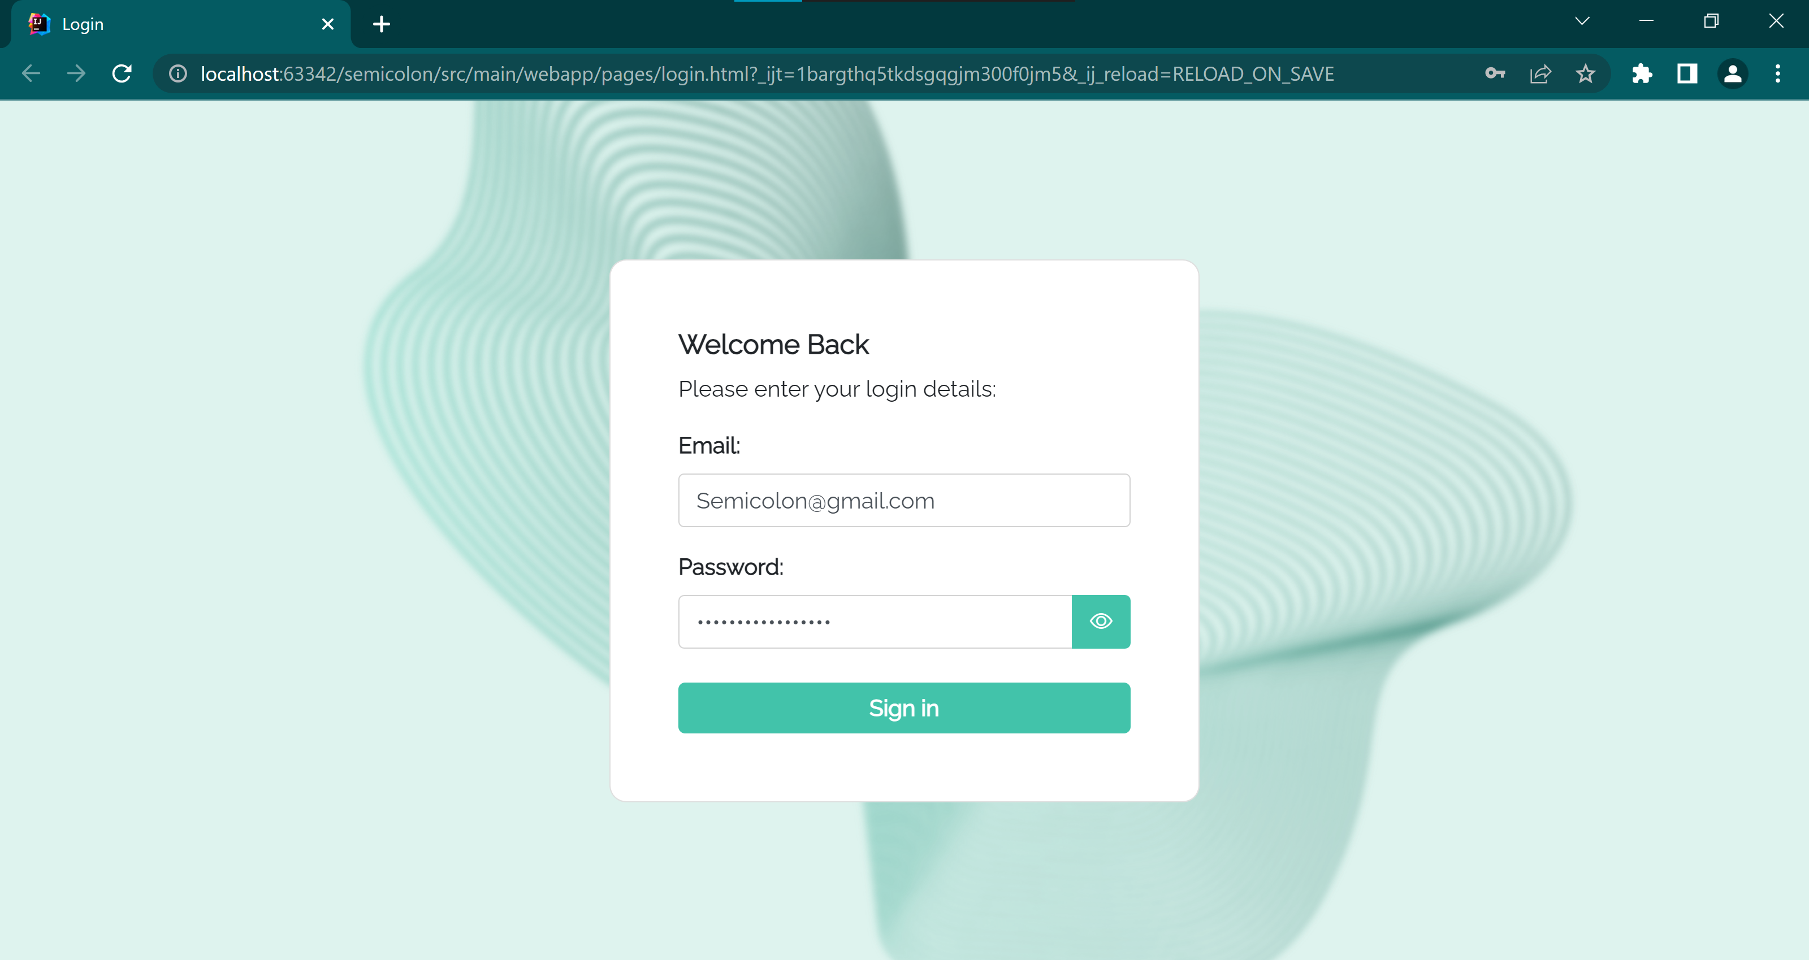
Login Page
24

Slide 27

02
Client-side

Slide 28

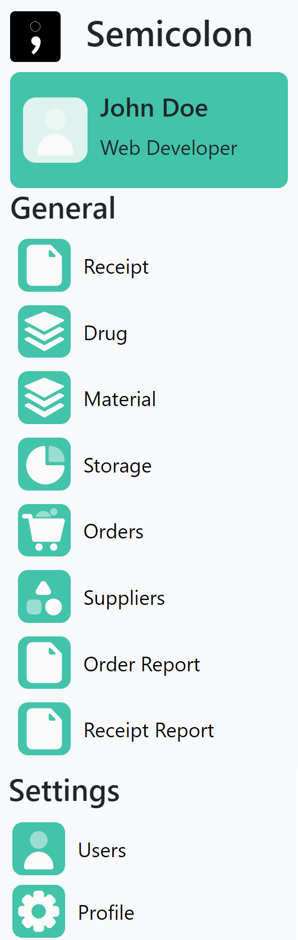
Sidebar
26

Slide 29
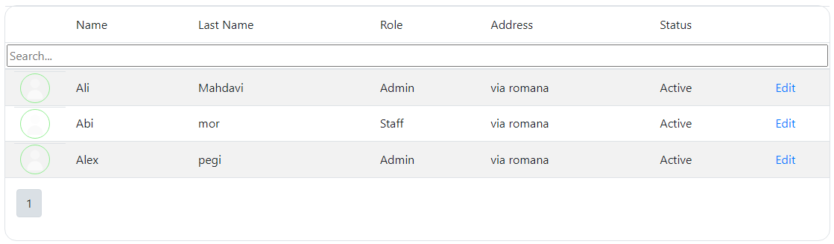
Tables
27

Slide 30
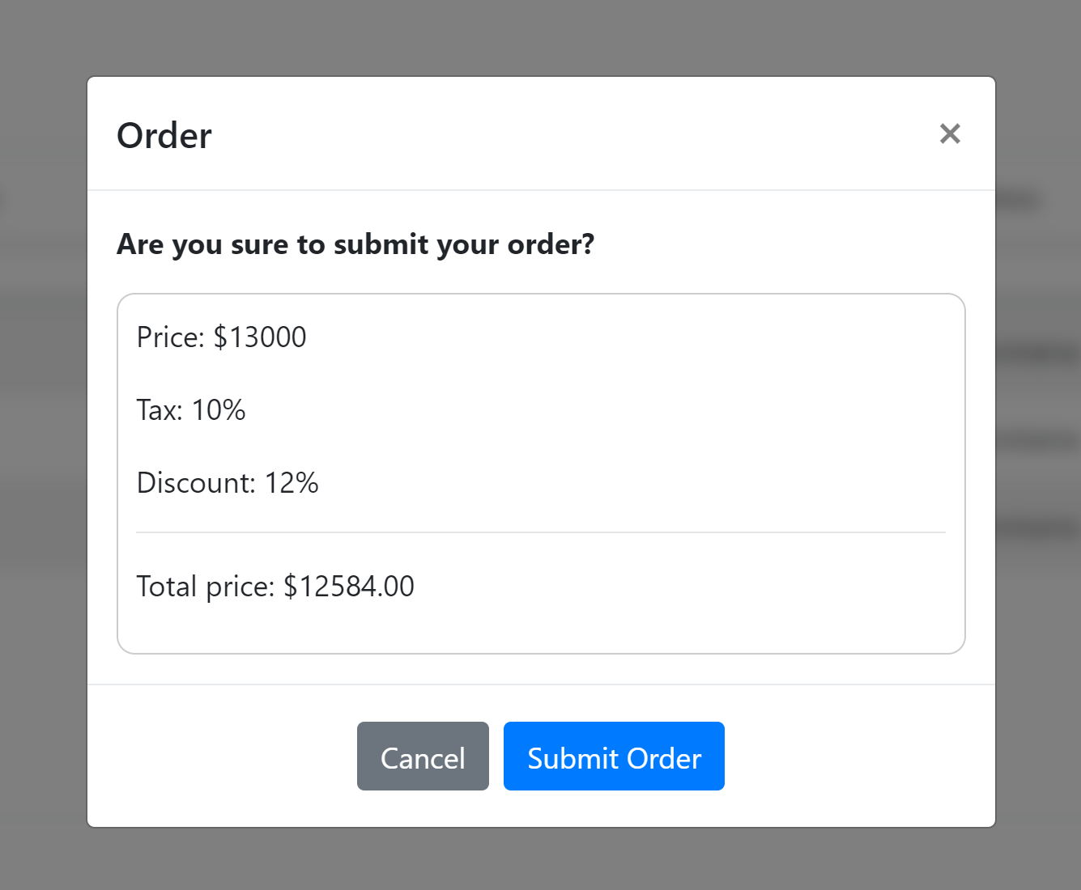
Modal
28
28

Slide 31
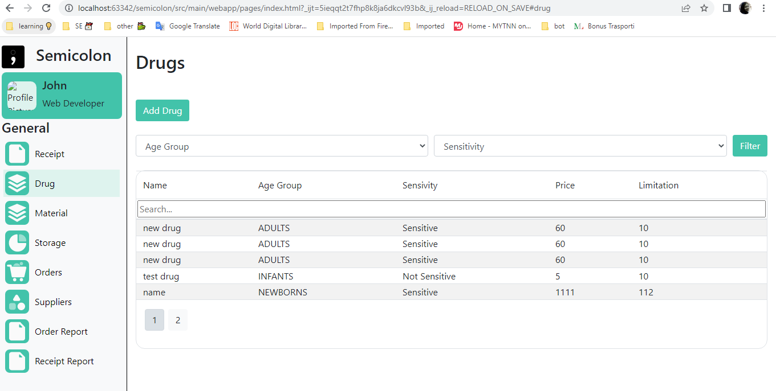
Drug Page
29

Slide 32
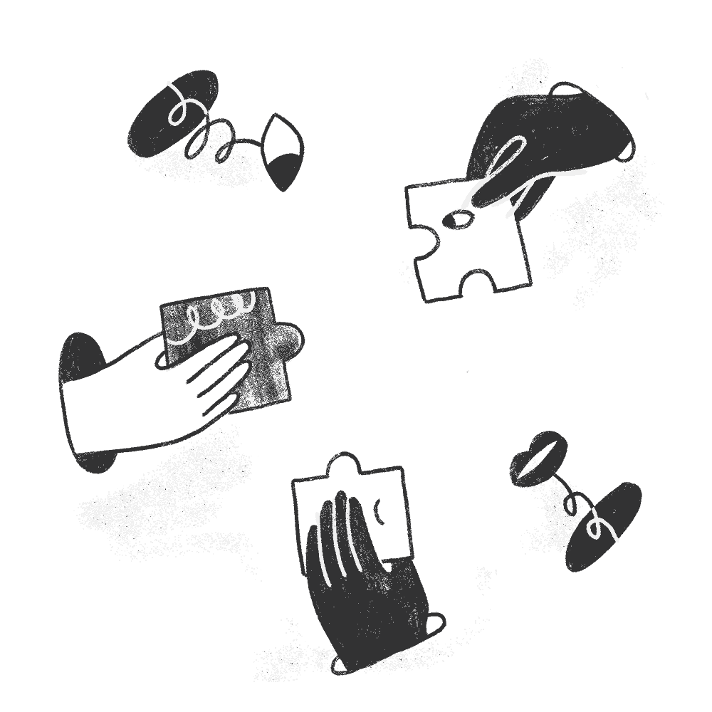

Contribution

Slide 33

Now let’s have a look at the demo…
31

Slide 34

Thanks!
Any questions?

